Slide 1
Chapter Eight
Installing Wireless and SOHO Networks

Slide 2


220-901 Objectives Covered
2.5 Compare and contrast various Wi-Fi networking standards and encryption types.
  Standards
    802.11 a/b/g/n/ac
    Speeds, distances, and frequencies
  Encryption types
    WEP, WPA, WPA2, TKIP, AES
2.6 Given a scenario, install and configure a SOHO wireless/wired router and apply appropriate settings.
  Channels
  Port forwarding, port triggering
  DHCP (on/off)
  DMZ
  NAT / DNAT
  Basic QoS
  Firmware
  UPnP
2.7 Compare and contrast Internet connection types, network types, and features.
  Internet connection types
    Cable
    DSL
    Dial-up
    Fiber
    Satellite
    ISDN
    Cellular
      Tethering
      Mobile hotspot
    Line of sight wireless Internet service
Notes:
Wi-Fi – refers to the family of IEEE802.11 Standards
Chapter 8 in-depth look at the 802.11 standards
And Wireless security standards

Slide 3
Wired vs Wireless
Similar in concept
Wired hub, wired switch, wired router
Wireless – router and access point (eventually wired)
SSID – service set identifier, name of the network

Slide 4
CSMA/CA vs CSMA/CD
Carrier Sense Multiple Access/Collision Avoidance (Wireless)
Carrier Sense Multiple Access/Collision Detection (Wired)
back-off time – waiting period if collision occurs
Notes:
Packet collisions are generally avoided, but when they do happen, the sender
will need to wait a random period of time (called a back-off time) before transmitting again
CA – Collision Avoidance - Wi-Fi devices will sit, listen and wait for the radio channel it is connected on to be quiet before it sends

Slide 5
Wireless Channels
2.4GHz and 5GHz
Notes:
The 2.4GHz range is divided into 14 channels, each spaced 5MHz apart.
Channels 1, 6, and 11 do not overlap
The 5GHz range has much more spectrum
In the U.S., they range from Channel 36, which is 5.180GHz, to Channel 165, which is 5.825GHz, giving us 25 usable channels.

Slide 6
802.11 Standards
802.11a
802.11b
802.11g
802.11n
802.11ac
Notes:
IEEE 802.11 was ratified in 1997 and was the first standardized WLAN implementation
In concept, an 802.11 network is similar to an Ethernet network, only wireless.
There are several wireless technologies on the market, but 802.11 is the one currently best suited for WLANs
802.11
Original (1Mbps or 2Mbps at 2.4GHZ frequency)

Slide 7
802.11 Standards
Standard | Year | Speed | Frequency | Modulation
802.11 | 1997 | 1Mbps-2Mbps | 2.4Ghz | FHSS or DSSS
802.11a | 1999-2001 | 54Mbps | 5Ghz | OFDM
802.11b | 1999 | 11Mbps | 2.4GHz | DSSS
802.11g | 2003 | 54Mbps | 2.4GHz | OFDM or DSSS
802.11n | 2010 | 600Mbps | 2.4GHz & 5GHz | OFDM or DSSS
802.11ac | 2014 | 6900Mbps | 5GHz | OFDM
Notes:
Frequency Hopping Spread Spectrum (FHHS) or Direct-Sequencing Spread Spectrum (DSSS)
Orthogonal frequency division multiplexing (OFDM)
802.11a
Most commonly, communication takes place at 6Mbps, 12Mbps, or 24Mbps.
802.11a is incompatible with the 802.11b and 802.11g wireless standards
802.11g
Because it operates in the same frequency and can use the same modulation as 802.11b, the two standards are compatible.
That was initially a huge selling point for 802.11g hardware and helped it gain popularity very quickly
When an 802.11b device is associated with an 802.11g access point, the access point reverts back to DSSS modulation to
provide backward compatibility (11Mbps)

Slide 8
Standard | Year | Speed | Frequency | Modulation
802.11 | 1997 | 1Mbps-2Mbps | 2.4Ghz | FHSS or DSSS
802.11a | 1999-2001 | 54Mbps | 5Ghz | OFDM
802.11b | 1999 | 11Mbps | 2.4GHz | DSSS
802.11g | 2003 | 54Mbps | 2.4GHz | OFDM or DSSS
802.11n | 2010 | 600Mbps | 2.4GHz & 5GHz | OFDM or DSSS
802.11ac | 2014 | 6900Mbps | 5GHz | OFDM or DSSS
Notes:
Understanding Channels:
14 different 22MHz channels allocated by the government
Only 1, 6 and 11 and non-overlapping – figure 8.1
802.11n
MIMO – Multiple input Multiple output – Combines channels in 22MHz range and 40MHz range (channel Bonding) to double the throughput
802.11n devices can support up to 8 antennas, or 4 streams, because each antenna only sends or receives.
Channel bonding also allows the device to communicate simultaneously at 2.4GHz and 5GHz and bond the data streams, which increases throughput backward compatible with 802.11a/b/g
Wi-Fi installations using the 5GHz range need to steer clear of radar signals to avoid conflicts. Radar for airplanes and weather stations has priority over your Wi-Fi network
**To avoid conflicts, wireless routers use a technology named dynamic frequency selection (DFS), which will detect radar interference and dynamically adjust to a different frequency range to avoid the problem

Slide 9
Standard | Year | Speed | Frequency | Modulation
802.11 | 1997 | 1Mbps-2Mbps | 2.4Ghz | FHSS or DSSS
802.11a | 1999-2001 | 54Mbps | 5Ghz | OFDM
802.11b | 1999 | 11Mbps | 2.4GHz | DSSS
802.11g | 2003 | 54Mbps | 2.4GHz | OFDM or DSSS
802.11n | 2010 | 600Mbps | 2.4GHz & 5GHz | OFDM or DSSS
802.11ac | 2014 | 1300Mbps | 5GHz | OFDM
Notes:
802.11ac
802.11ac can bond up to 8 channels as opposed to 2 as in 802.11n
802.11ac doubles the MIMO capabilities of 802.11n to eight streams, resulting in another 100 percent speed increase
Beamforming, which can allow for range increases by sending the wireless signal in the specific direction of the client as opposed to broadcasting it omnidirectionally

Slide 10
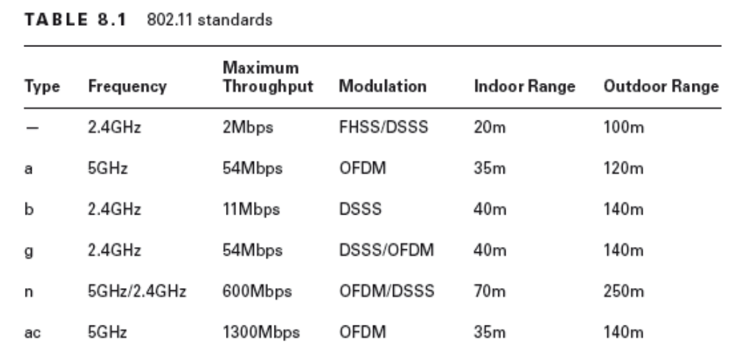

Slide 11
Modulation Techniques
Frequency-hopping spread spectrum (FHSS)
Direct-sequence spread spectrum (DSSS)
Orthogonal frequency division multiplexing (OFDM)
Notes:
FHSS accomplishes communication by hopping the transmission over a range of predefined frequencies. The changing, or hopping, is synchronized
between both ends and appears to be a single transmission channel to both ends
DSSS accomplishes communication by adding the data that is to be transmitted to a higher-speed transmission. The higher-speed transmission contains redundant information to ensure data accuracy. Each packet can then be reconstructed in the event of a disruption.
OFDM accomplishes communication by breaking the data into subsignals and transmitting them simultaneously. These transmissions occur on different frequencies or subbands.

Slide 12
Wireless Encryption Methods
WEP
WPA
WPA2
Notes:
A more effective way of securing your network than not broadcasting your SSID

Slide 13
WEP
Wired Equivalent Privacy
It uses a static key
The keys are commonly 10, 26, or 58 hexadecimal characters long
WEP.64 -10-character key. WEP.128 – 26 characters, and WEP.256 uses 58
Notes:
WEP is vulnerable due to the nature of static keys and weaknesses in the encryption algorithms
Can be cracked in a very short amount of time (3mins)

Slide 14
WPA
Wi-Fi Protected Access
Improvement to WEP
Temporal Key Integrity Protocol (TKIP) – uses a 128-bit dynamic per-packet key. It generates a new key for each packet sent
Notes:
Both WPA and WPA2 (discussed next) have two variants: personal and
enterprise. For a small office or home office network with just one wireless
router or access point, personal is the choice to make. With personal,
the device itself handles the authentication. For larger networks, enterprise
is recommended because it consolidates authentication administration.
Enterprise requires the use of a separate central authentication
server, such as a Remote Authentication Dial-in User Service (RADIUS)
server.

Slide 15
WPA2
Wi-Fi Protected Access 2
Uses CCMP (Counter-Mode CBC-MAC) – Improvement to TKIP
CCMP is based of federal Govt’s Advanced Encryption Standard (AES)
Provides privacy, integrity and authentication
Notes:
The AES is an encryption algorithm for securing sensitive - unclassified material by government agencies
WPA2 uses an encryption device that encrypts the network with a 256-bit key
Since 2006, wireless devices have been required to support WPA2 to be certified as Wi-Fi compliant. Of the wireless security options available today, it provides the strongest encryption and data protection

Slide 16
Choosing Internet Connections
Dial-up/POTS
DSL
Cable
ISDN
Fiber-optic
Satellite
Cellular WAN
Notes:
POTS
Dial-up uses modems that operate over regular phone lines—that is, the plain old telephone service (POTS)—
Cheap and easy to configure (modem and phone chord)
You dial in to a server (such as an ISP’s server), provide a username and a password, and you’re on the Internet
DSL
Digital Subscriber Line
Needed - DSL modem and a network card in your computer
RJ45 cable to connect PC and RJ-11 for phone
You can also use a wireless router
DSL splitter (fig 8.6) allows for clean phone and internet)
Faster than dial-up
Bandwidth not shared by others
Reliable

Slide 17
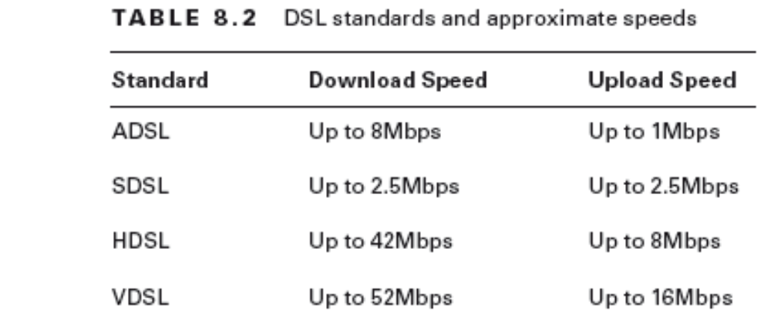
DSL Forms
Asymmetric DSL
Symmetric DSL (SDSL),
High bit-rate DSL (HDSL),
Very high bit-rate DSL (VDSL)
Notes:
The most popular in-home form of DSL is ADSL. It’s asymmetrical because it supports download speeds that are faster than upload speeds

Slide 18
Choosing Internet Connections
Dial-up/POTS
DSL
Cable
ISDN
Fiber-optic
Satellite
Cellular WAN
Notes:
Cable
Services through cable lines as opposed to telephone lines
Anyone who can get cable TV can get it
Needed - cable modem and standard Ethernet cable or AP
Cable Internet provides broadband Internet access via a specification known as Data Over Cable Service Internet Specification (DOCSIS)
Faster than DSL but shared bandwidth (100 to 200 customers)
Slow at peak times but Reliable
ISDN
Digital, point-to-point network capable of maximum transmission speeds of about 2Mbps
ISDN uses the same two-pair UTP wiring as POTS (but it can transmit data at much higher speeds)
Instead of carrying an analog (voice) signal, it carries digital signals
ISDN terminal adapter (often referred to as an ISDN TA or ISDN modem or Router for many users)

Slide 19
ISDN Channels
B or Bearer – data
D or Signal - call setup and link management
Service Categories:
BRI 2B+D– Home and small business
PRI 23B+D– Large users
Notes:
The B channels are used for voice or user data, and the D channel is used for any combination of data, control/signaling, and X.25 packet networking
BRI – Basic Rate Interface (2B+D)
A typical 144Kbps basic rate interface (BRI) ISDN line has two B channels and one D channel.
One B channel can be used for a voice call while the other is being used for data transmissions, or both can be used for data. When the B channels are combined to maximize data throughput (which is common), the process is called bonding or inverse multiplexing. Multiple BRI ISDN lines can also be bonded together to form higher throughput channels.
Primary rate interface (PRI),
AKA 23B+D, which means it has 23 B channels and 1 D channel
The total bandwidth of a 23B+D ISDN line is 1,536Kbps (23 B channels × 64Kbps per channel + 64Kbps for the D channel).

Slide 20
Fiber Optic
Fiber-to-the-Home (FTTH) service – e.g. Verizon FiOS (75Mbps Max )
Fiber-to-the-Node (FTTN), sometimes called Fiber to the Curb (25 Mbps Max )

Slide 21
Satellite
Uses a satellite dish to receive data from an orbiting satellite and relay station that is connected to the Internet
Slower than broadband - 10Mbps to 15Mbps and uploads at 1Mbps to 2Mbps
Notes:
It’s expensive compared to other broadband access
Installation can be tricky
Line of sight is required
Latency can be a problem.

Slide 22
Cellular WAN
Cell phone standards:
Global System for Mobile Communications (GSM)
Code division multiple access (CDMA) – USA
Both are 3G
4G and 4GLTE (long term evolution) are the new standards
Notes:
Both are incompatible
Provider dependent - Sprint and Verizon use CDMA, and AT&T and T-Mobile use GSM

Slide 23
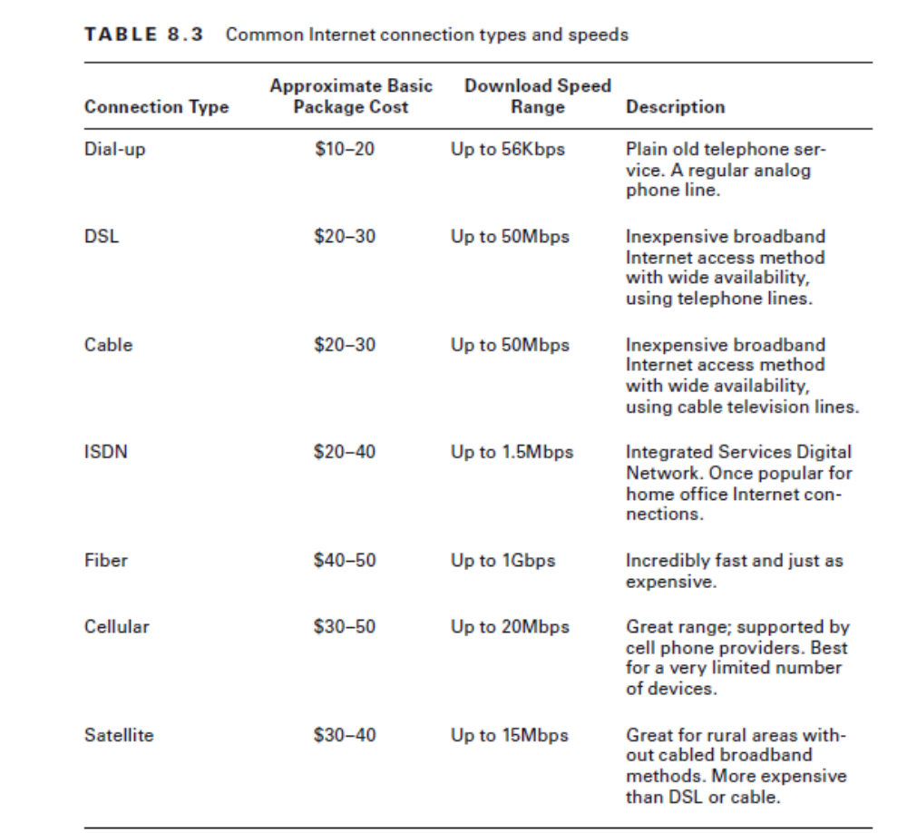

Slide 24
Internal Connections
Wired
  Copper
  Fiber-optic
  Ethernet standards
Wireless
  Wi-Fi
  Bluetooth
  Infrared

Slide 25
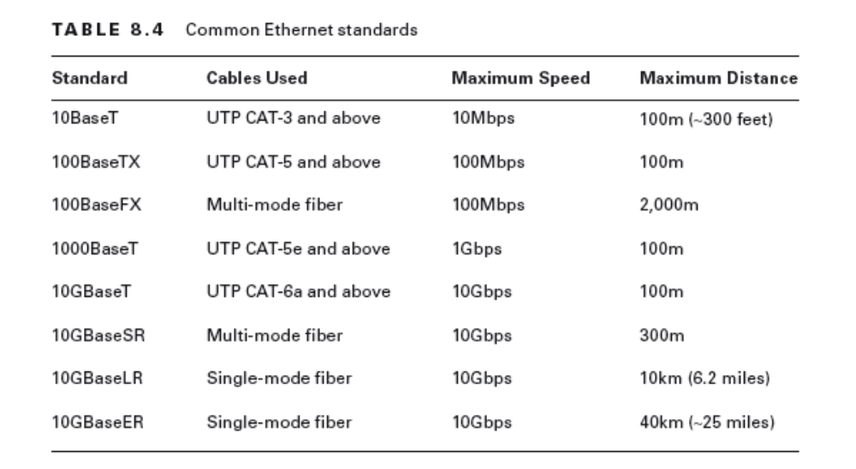
Ethernet Standards

Slide 26
Installing a Network
Planning
Physical Installation
Configuring Routers

Slide 27
Router Configuration
Basic Configuration
  Channels
  NAT
  UPnP
Additional Services
  Firewall
  QoS
Notes:
1. Change the router’s SSID.
2. Change the administrator username and password. Make sure it’s a strong password.
3. Select AES or WPA2.
4. Choose a high-quality security passphrase.
5. From the clients, select WPA2 and enter the security passphrase to connect.
Universal Plug and Play:
Universal Plug and Play (UPnP) is a standard designed to simplify the process of connecting
devices to a network and enable those devices to automatically announce their presence
to other devices on the network.
It lets devices connect to the network and discover each other
automatically with the Simple Service Discovery Protocol. It can be used for any networked
device you can think of, from routers and printers to smartphones and security cameras.
Disadv: No authentication

Slide 28
Router Configuration
Basic Configuration
  Channels
  NAT
  UPnP
Additional Services
  Firewall
  QoS
Notes:
Firewalls:
Firewalls are configured to allow only packets that pass specific security restrictions to get
through them. They can also permit, deny, encrypt, decrypt, and proxy all traffic that flows
through them, most commonly between the public and private parts of a network
Network-based firewalls A network-based firewall is what companies use to protect their
private network from public networks
Host-based firewalls In contrast to network-based firewalls, a host-based firewall is
implemented on a single machine so it protects only that one machine
Quality of Service:
Quality of Service (QoS) is a strategy that allows an administrator to control traffic to
maintain a certain service level. By using QoS, an administrator can set different priorities
for one or more types of network traffic based on different applications, data flows, or
users. For example, if the engineering group needs to have a certain amount of guaranteed network bandwidth, QoS can make that happen.

Slide 29
QOS Focus areas
Delay – congestion
Dropped packets
Error/corrupt data
Jitter or variation in packet delay
Out of order delivery - VOIP
Notes:
QoS focuses on dealing with five different types of problems that can affect data on a
network:
■■ Delay, usually caused by congested routes that prevent critical data from arriving on time
■■ Dropped packets, which often causes delay
■■ Error, or corrupted data
■■ Jitter, or variation in packet delay in a data stream
■■ Out-of-order delivery, which can cause performance issues in time-sensitive applications such as VoIP.

Slide 30
QoS Continued
Higher-level = higher priority,
Administrators can set priority levels 0 through 5 based on an SLA

Slide 31
QoS Levels
TA B L E 8 . 8 QoS levels
Level Description
0 Best effort
1 Background
2 Standard
3 Excellent load (business-critical applications)
4 Controlled load (streaming media)
5 Interactive voice and video (less than 100ms latency)
6 Layer 3 network control reserved traffic (less than 10ms latency)
7 Layer 2 network control reserved traffic (lowest latency)

Slide 32
Port Triggering
Default deny/allow
Notes:
port triggering - allows traffic to enter the network on a specific port after a computer makes an outbound request on that specific port. (e.g Telnet = Port 23)

